Slide 1
RE/MAX Housing Prediction Model
August 2022
Notes:
Welcome
Introduce self as part of statistical consulting team
Excited to deliver a strong predictive model for housing prices

Slide 2
Executive Summary
Question | What model can most accurately predict housing prices using data scraped from online resources?
High Level Summary | We evaluated 11 models from 3 families Tree-based methods had the strongest prediction accuracy
Next Steps | Implement the tuned XGBoost algorithm to predict housing prices
Data | Training/Validation Sources: CollegeCr.csv, Edwards.csv, OldTown.csv Test Sources: CollegeCr.test.csv, Edwards.test.csv, OldTown.test.csv
Watchouts | Columns are not consistently available between datasets Duplicates present in data Missing values required imputation Model training excluded anomalous records
Notes:
Neal engaged us to predict sale prices of houses in his region
Trained models based on data his team scraped from online resources in three neighborhoods
The provided data required cleaning and transformation
We compared models using consistent evaluation criteria and found one clear winner that we are confident can deliver accuracy!

Slide 3
Data Quality Remediation and Transformations
Derived Neighborhood variable from file names.
Split into multiple variables:
Exterior → Exterior1st, ExteriorQual, ExteriorCond
LotInfo → LotConfig, LotShape, LotArea, LotFrontage
Removed:
3 full row duplicates
Anamoly with YrSold 2001 and YearBuilt 2004
Utility, BsmtUnfSF, and KitchenAbvGr columns
Filled in empty:
BsmtQual, BsmtFinType1, and GarageType with NA
LotFrontage with 0
Notes:
Created new categorical variable “Neighborhood” based on which of the 3 files we received from
Two columns contained multiple variables embedded within
3 rows were full duplicates
Anamolous record with year sold prior to year built, client confirmed removal
Utility was uniformly one value and provided no predictive power
BsmtUnfSF and KitchenAbvGr not available across all files, client confirmed removal
Empty qualitative variables filled with NA, consistent with other values
LotFrontage filled with 0, possibly no

Slide 4
Model Families Evaluated
Family | Objective
Linear Regression with Stepwise Selection | Add or remove one variable at a time and evaluate model accuracy
Shrinkage Methods | Shrink the coefficient estimates towards zero by applying a penalty
Tree-Based Methods | Partition the predictor variable space into several simple regions with predicted responses
Notes:
Evaluated 3 families of predictive models
Linear Regression: Traditional “line of best fit” that expresses relationship between those points.
Evaluated severable predictor variable selection techniques. Helps simplify the model and avoid redundant variables that can hurt performance.
Forward: Find first variable that adds most predictive power. Continue adding next most powerful variable one at a time. Stop when no longer significant.
Three separate criteria to evaluate “best model” (won’t get into detail), but selected a model that optimized each of the 3
Backward: Reverse of forward but start with all variables and remove one at a time
Shrinkage: Tune a penalty that either shrinks variables close to 0 or entirely to 0
Tree-Based: Find rules that split variables into partitions, each with their own prediction. Results in a flowchart-like algorithm.

Slide 5
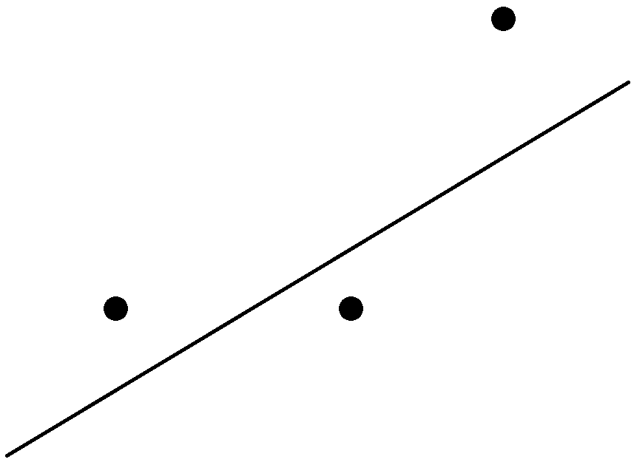








Model Comparison Measure
Mean Squared Error (MSE): The squared distance of each actual observed value $y_{i}$ from the predicted value divided by the number of observations.
Measured vertically
$$y_{3}$$
$$d_{3}$$
$$MSE=\frac{d_{1}^{2}+d_{2}^{2}+d_{3}^{2}}{3}$$
$$y_{1}$$
$$d_{2}$$
$$d_{1}$$
$$y_{2}$$
Notes:
Found the most consistent measure to compare difference between prediction and true value is MSE
Simple example below, we have 3 dots representing true observations and line representing predictions
Important note: measure vertically, NOT closest point on the line (ensures we represent correct prediction)
Square the difference (ensures it is always positive value), add together, and divide by number of predictions
Hence: Mean-Squared Error

Slide 6
Splits for Model Evaluation
Training | Validation | Test
Optimize each model against this set | Compare models | Predict
CollegeCr.csv Edwards.csv OldTown.csv | CollegeCr.test.csv Edwards.test.csv OldTown.test.csv
Notes:
3 partitions to adequately fit models and have a fair comparison between
College Circle, Edwards, and Old Town randomly assigned into either Training/Validation
Training: Fit each model
Validation: Simulates data not yet encountered by model. Selected model with smallest Mean-Squared Error against.
Test: No Sale Price, so will serve as first set of predictions. Once these homes are sold, will have most true evaluation of performance yet.

Slide 7
Mean Squared Error Comparison
Family:
Notes:
Happy to report the Decision Trees performed the strongest as they are easiest to explain!
Surprisingly, Linear Regression outperformed Shrinkage Methods (usually the reverse). Likely a product of missing data.
We see each Linear Regression model split by Forward vs. Backward, and each of the 3 performance measures we optimized (BIC, Cp, and Adj R^2)
Based on significant margin for lowest MSE, we recommend XGBoost.

Slide 8
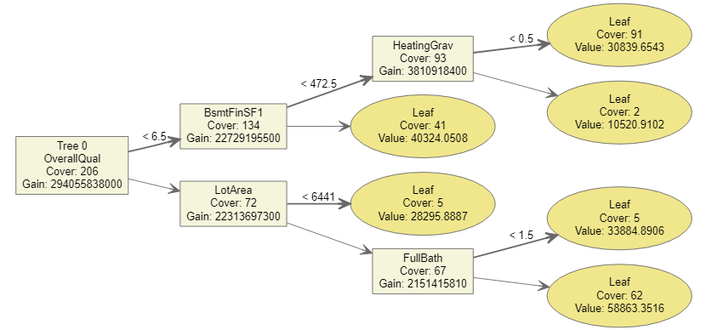
XGBoost Overview
eXtreme Gradient Boosted trees
Ensemble method
Based on predicting errors from previous models in algorithm
Learns slowly to avoid overfitting
Notes:
XGBoost = eXtreme Gradient Boosted Trees
Ensemble method, theory: Number of pieces of candy in a jar, in general the mean of all guesses outperforms random individual guess.
In ML, ensemble combines several models to produce one predictive model
Each new tree iterates on previous trees to correct error (called boosting), but deliberately corrects slowly
Avoids overfitting, where model predicts too closely to training data at cost of poor performance against future data

Slide 9
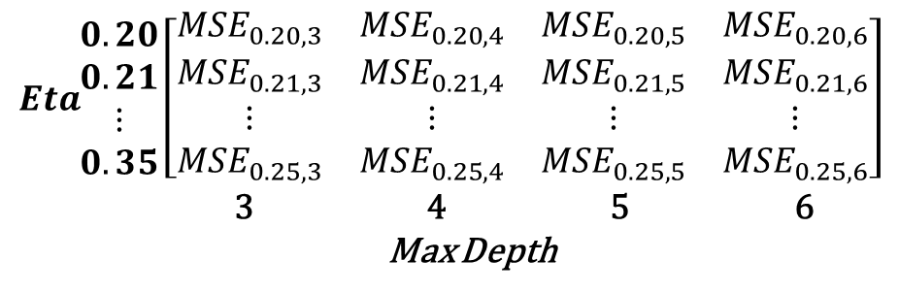
Hyperparameter Tuning
Max Depth: Number of layers allowed
Eta: Learning rate
Partition data and evaluate over grid of Max Depth & Eta combos
Max Depth 3 and Eta 0.27 had minimum MSE.
$$\begin{matrix}Eta\end{matrix}\begin{matrix}0.20 \\ 0.21 \\ ⋮ \\ 0.35\end{matrix}\left[\begin{matrix}{MSE}_{0.20,3} & {MSE}_{0.20,4} & {MSE}_{0.20,5} & {MSE}_{0.20,6} \\ {MSE}_{0.21,3} & {MSE}_{0.21,4} & {MSE}_{0.21,5} & {MSE}_{0.21,6} \\ ⋮ & ⋮ & ⋮ & ⋮ \\ {MSE}_{0.25,3} & {MSE}_{0.25,4} & {MSE}_{0.25,5} & {MSE}_{0.25,6}\end{matrix}\right]$$
3 4 5 6
Max Depth
Notes:
XGBoost algorithm requires that we tune some inputs (or hyperparameters) to optimize performance
Max Depth: The number of layers (or maximum splits to arrive at leaf node) allowed. Controls overfitting.
Eta (Greek letter): The rate we allow each tree to correct over the previous iteration. Trade off between optimum result and computing resources.
Divide training data into 5 partitions, train data on 4 and reserve 1 to predict against and measure error.
For each combination in grid of Max Depth & Eta, find the MSE.
Selected Max Depth 3 and 0.27

Slide 10
XGBoost Model Results
Remaining 54 features have remaining 3.2% overall importance.
Notes:
Decision tree methods output how useful/valuable a feature is to construction
Tree calculates amount each attribute improves MSE
Averaged across all trees within the current XGBoost model
Top 17 variables shown, with Overall Quality holds 50% of importance (often found same variable was influential on other models we evaluated)
54 variables not shown only share remaining 3.2% of importance

Slide 11
Next Steps
Deliver predictions from current test dataset.
Deploy XGBoost model predict future sale prices.
Notes:
Deliver predictions: We will submit a CSV file that contains the identifier for each house in test dataset and our predicted value.
Deploy XGBoost model: There is a Github link to the codebase available in the Appendix we will hand off to your engineers.

Slide 12
Appendix

Slide 13
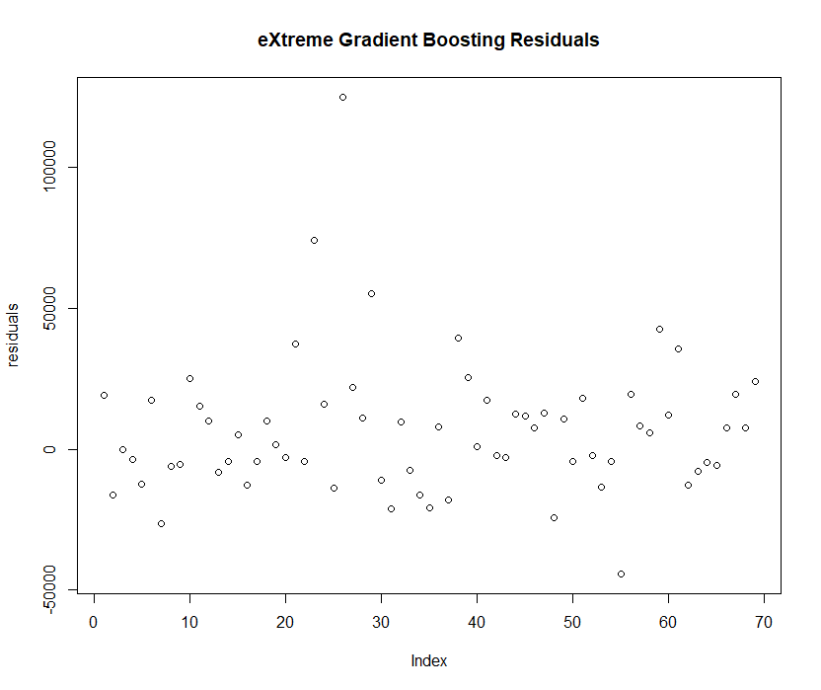
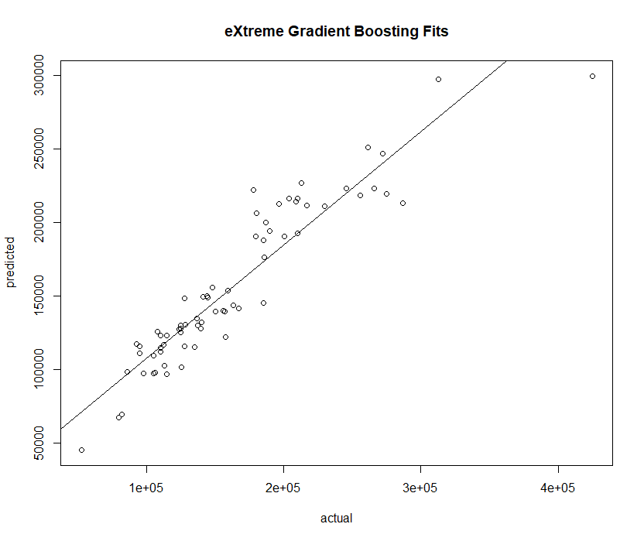
XGBoost Validation
Notes:
Additional evidence for validating model assumptions
Left side, Residuals: we are looking for roughly horizontal band – except for one outlier, SATISFIED
Right side, Fits: We are looking for a tight grouping around the line - SATISFIED

Slide 14
Github Repository
Code and project work is available on Github: https://github.com/Sweigalytics/STAT580_Project2
Notes:
If you follow Github link, you will find predictions and R code for the model
Additional questions, please reach me in the meantime.

